Slide 1
Machine Learning
DePaul IPD Program Lecture Course

Slide 2
Learning Goals
When to apply machine learning (and when not to)
The limitations of machine learning
Understand what type of problem you are facing
How to evaluate the advantages and drawbacks of different algorithms
Know some of the main machine learning algorithms

Slide 3
Who Am I?
Dice.com’s Chief Data Scientist
Data Science labs page
DePaul PhD Candidate, Machine Learning and NLP
Dissertation Topic: Extracting Causal Inferences from Student Essays to Construct a Semantic Model

Slide 4
Overview
What is Machine Learning?
Types of Machine Learning Problems
Supervised Learning
Classification
Regression
Unsupervised Learning
Clustering
Dimensionality Reduction
Optimization
Reinforcement Learning
Limitations of Machine Learning
When to apply Machine Learning
What are the limitations
Notes:
Aim is to provide an overview of the different concepts, and then cover the core algorithms, using the algorithms to expand on the concepts introduced earlier.
Most of the early stuff won’t really make sense until they’ve seen some of the algorithm descriptions.

Slide 5
Overview
Bias Variance Trade Off
Bias
Variance
Definition of regularization
Introduction to Machine Learning Algorithms
Anatomy of an ML algorithm
Learning algorithm
Model
Objective (loss) function
Curse of Dimensionality
Important Attributes of a Machine Learning Algorithm to consider
Accuracy
Interpretability
Simplicity
Definition of hyperparameter
Robustness to Noise
Bias
Scalability (Large # rows, Large # dimensions, Vectorize? Parallelize?)
Core Supervised Learning Algorithms
Linear and Logistic Regression
Linear Separability
What is a linear model?
Trees
K-Nearest Neighbor
Neural Network
SVM
Ensembles – what and why
Notes:
Briefly discuss Bias vs Variance and algorithm properties before going over in detail during the algorithms discussion
For the supervised learning algorithms – talk about re-occurring concepts in ML algorithms – similarity, entropy \ trees, least squares fit, additive models, separating hyperplanes, gradient descent

Slide 6
Overview
Unsupervised Learning
Clustering – k means
Association Rule Mining
Dimensionality Reduction
Optimization
Genetic Algorithms
Other algorithms
Reinforcement Learning
Content Recommendations
Deep Learning
What is deep learning?
Extension from Neural Networks
When to consider deep learning, and when not

Slide 7
What is Machine Learning?
Some example definitions:
Arthur Samuels (1959)
“Field of study that gives computers the ability to learn without being explicitly programmed”
Tom Mitchel (1999)
“A computer program is said to learn from experience E with respect to some class of tasks T and performance measure P, if its performance at tasks in T, as measured by P, improves with experience E”
Notes:
Tom Mitchel – i.e. the algorithm learns to reduce the number of mistakes (classification) or the size of the error from data

Slide 8
Is Machine Learning AI?
Arises from the 2 fields of artificial intelligence and statistics
The most commercially successful application of AI
Traditional AI deals with reasoning i.e. logical inference, game theory and planning.
Machine learning focuses on learning from data
Machine Learning in the Web
Some examples of machine learning:

Slide 9
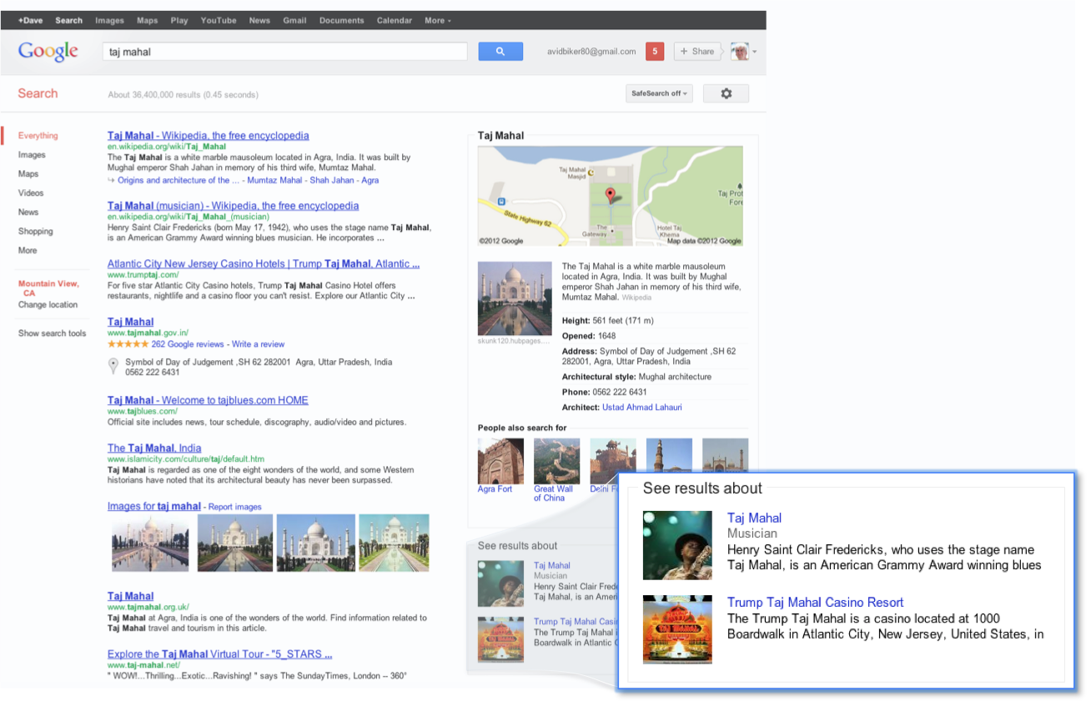
Google Search + Knowledge Graph
Notes:
PageRank is a machine learning algorithm

Slide 10
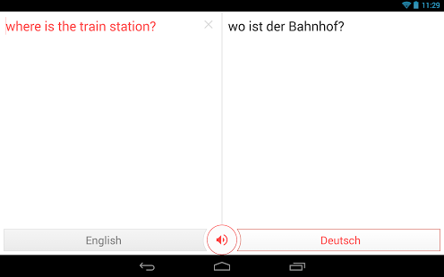
Google Translate

Slide 11
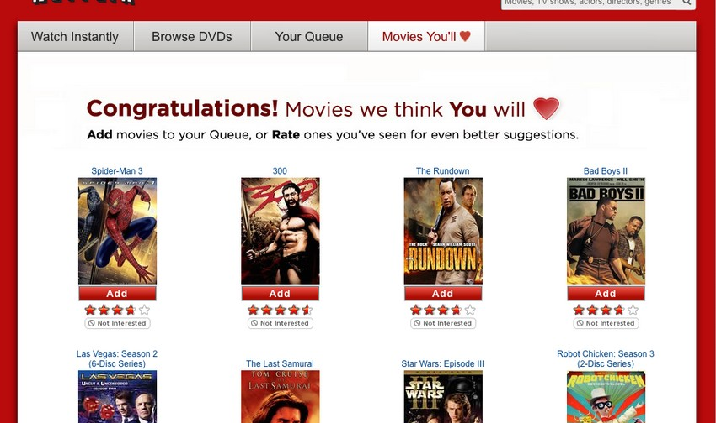
Netflix Movie Recommendations

Slide 12

Amazon’s “Customers … also bought”

Slide 13
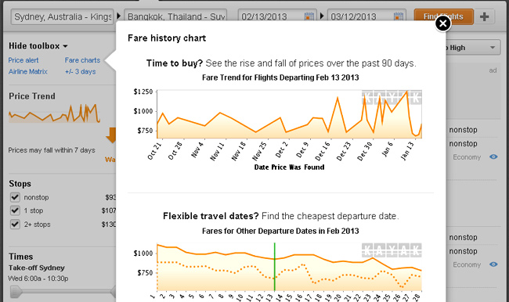
Kayak Fare Predictor

Slide 14
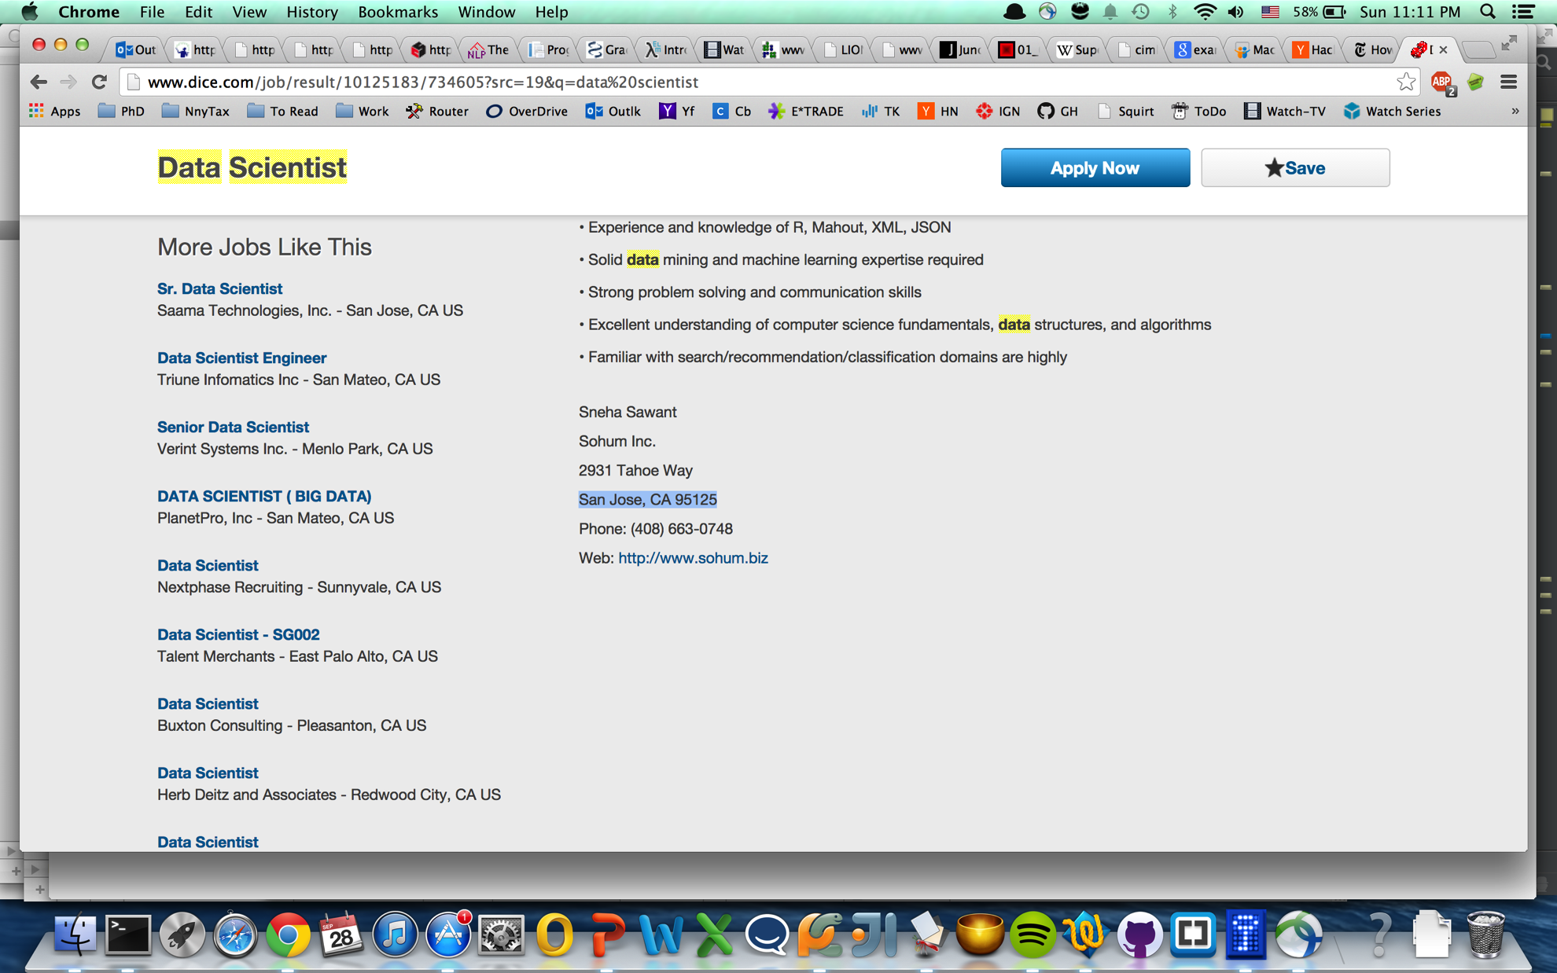
Dice More Jobs Like This

Slide 15
Supervised Learning
Mapping a set of inputs to a label
Predicting some event, label or numeric value, categorizing some items
E.g. predicting a person’s salary from their job description or determining the subject of a news article (sports, finance, news, etc)
Tabular View:
 | Col1 | Col2 | Col3 | Col… | Label (learn to predict)
Row1 | X1.1 | X1.2 | X1.3 | X1… | Label1
Row2 | X2.1 | X2.2 | X2.3 | X2… | Label2
Row… | … | … | … | … | …
RowN | XN.1 | XN.2 | XN.3 | XN… | LabelN

Slide 16
Why Do Machine Learning?
Automation of tasks previously requiring intelligence and domain expertise
Solve very hard problems that defy a programmatic solution
e.g. recent ILSVCR Google object recognition results (Imagenet dataset)
Consistent error rate
Adapt to changing conditions
e.g. stock market

Slide 17
Classification Problems
Classification
Predict a categorical (nominal) value
Binary
E.g. rain tomorrow? Yes/No Has Brain Tumor? True\False
Multiclass
E.g. What language is this document written in?
One vs Rest \ One vs All
One vs One
Multi-class, Multi-label
What entities are mentioned in this sentence? Places, People, Countries, Companies?
All strategies reducible to One vs Rest strategy
Regression
Predict a continuous variable (real number)
E.g. what will the price of gasoline be in a month? What will be the temperature tomorrow?

Slide 18
Unsupervised Learning
Finding patterns in data
Clustering: Grouping data points by similarity
Dimensionality Reduction: Projecting data into a lower dimensional space
Association Rules Mining: Find attributes that tend to occur together – market basket analysis
Can also be supervised with a target label
Optimization
Searching through potential solutions, to find the best solution to a problem
Best: Cheapest, fastest, shortest, etc
Important applications to optimizing machine learning algorithms

Slide 19
Reinforcement Learning
Learning to act optimally from interacting in some environment
Learning is usually online
Reward \ Punishment drives learning
Notes:
Example – training a car to race around a virtual track.

Slide 20
What Kind of Problem?
Supervised \ Unsupervised \ Optimization \ Reinforcement-Learning
Supervised : Classification \ Regression
Unsupervised : Clustering \ Dimensionality Reduction \ Association Rule Mining
Determining someone’s credit score
Accepting \ Denying car insurance coverage
Compressing a large dataset to speed up some machine learning algorithm
Is this document written in a positive, negative or neutral manner?
Discovering groups of similar users
Determining which books are bought together on an online bookstore
Learning to fly a drone
Predicting a second hand car’s value

Slide 21
What Kind of Problem…
Supervised \ Unsupervised \ Optimization \ Reinforcement-Learning
Supervised : Classification \ Regression
Unsupervised : Clustering \ Dimensionality Reduction \ Association Rule Mining
Predicting the value of the S&P tomorrow
Deciding what (letter) grade to assign an essay
A robot learning to navigate a maze
Deciding which content to display on an online news site
Finding the shortest route to deliver a set of parcels from a parcel delivery company
Deciding if a document is relevant to a search engine query
What set of investments will maximize my rate of return while reducing my risk profile
Tagging an image

Slide 22
Limitations of Machine Learning
Machine learning (ML) algorithms learn from historical data - equivalent to a observational study
Detects correlation NOT causation
“Correlation does not equal causation”
ML algorithms can indicate potential causal factors but..
Experiments – such as randomized controlled trials – required to determine causality

Slide 23
Why use Machine Learning?
Discuss

Slide 24
Why use Machine Learning?
Make predictions \ classifications from data (main use)
Indicate potential causal factors
Provide an possible interpretation for some phenomenon
Find unknown patterns in data

Slide 25
What is the Goal of Training a ML Algorithm
Discuss
Notes:
Question for class

Slide 26
What is the Goal of Training a Machine Learning Algorithm?
Generalization – create a model that generalizes to new unseen data
Train model on one dataset (training data), evaluate on second unseen dataset (validation dataset \ test dataset)
Performance on the validation data is all that matters
2 Challenges to achieving low out of sample error:
Overfitting (a.k.a. variance)
Model has memorized training data
Model has not generalized
Test analogy – model has memorized the questions and answers to some test, rather than understood the subject matter
Underfitting (a.k.a. bias)
Model structure is a poor fit for the problem
Two key ways this is manifested
Linear models on non-linear data, or the learner is unable to capture the structural shape of the problem
Independence assumptions between features that are highly inter-dependent
Notes:
Lead into linear models

Slide 27
K-Nearest Neighbor Algorithm
Find the most similar k-data points, use them to compute a the label through voting
Uses a similarity metric
Given new data point, compute pairwise similarity to all other training data points
Voting Schemes:
Majority votes wins (k should be odd to resolve ties)
Weighted vote – votes are weighted by similarity
Lazy learner – no model is constructed in ‘training phase’, similarity calculations done when model is evaluated
No training overhead, slow run time performance

Slide 28
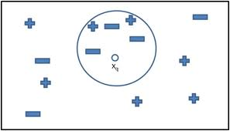
K-Nearest Neighbor Algorithm

Slide 29


Similarity \ Distance Metrics
Euclidean Distance:
Manhattan Distance
To get a similarity measure, compute:
Sim = 1/distance(x1,x2)
Sim = (1- distance(x1,x2)
if distance in [0,1]
Notes:
Equation images from wikipedia: http://en.wikipedia.org/wiki/Euclidean_distance - as of 10/6/2014

Slide 30
Iris Dataset – Compute k-nn
Sepal Length | Sepal Width | Petal Length | Petal Width | Class
5.3 | 3.7 | 1.5 | 0.2 | Iris-setosa
5 | 3.3 | 1.4 | 0.2 | Iris-setosa
7 | 3.2 | 4.7 | 1.4 | Iris-versicolor
6.4 | 3.2 | 4.5 | 1.5 | Iris-versicolor
7.7 | 2.6 | 6.9 | 2.3 | Iris-virginica
6 | 2.2 | 5 | 1.5 | Iris-virginica
5.1 | 3.4 | 1.5 | 0.2 | ???
Compute:
Euclidean distance to each of 6 data points above
Which is the class assigned by k-nn for k = 1? k=4

Slide 31


Feature Normalization
K-nn needs data to be pre-processed
Data should be normalized
Standard Score normalization –
Feature Scaling –
What happens if data is not normalized?
Notes:
Why? Large data values dominate the
Equation images from wikipedia: http://en.wikipedia.org/wiki/Normalization_(statistics) - as of 10/6/2014

Slide 32
Iris Dataset – Feature Normalize
Sepal Length | Sepal Width | Petal Length | Petal Width | Class
5.3 | 3.7 | 1.5 | 0.2 | Iris-setosa
5 | 3.3 | 1.4 | 0.2 | Iris-setosa
7 | 3.2 | 4.7 | 1.4 | Iris-versicolor
6.4 | 3.2 | 4.5 | 1.5 | Iris-versicolor
7.7 | 2.6 | 6.9 | 2.3 | Iris-virginica
6 | 2.2 | 5 | 1.5 | Iris-virginica
Compute:
Normalize Sepal Length and Width using feature scaling
Compute min, max and max-min
Plug into

